Slide 1
Hierarchical Diffusion Curves for Accurate Automatic Image Vectorization
Guofu Xie^{1,3} Xin Sun² Xin Tong² Derek Nowrouzezahrai¹
¹University of Montreal
²Microsoft Research
³State Key Laboratory of Computer Sciences, ISCAS
Notes:
Good afternoon. In this talk, I will introduce an accurate and automatic image vectorization using hierarchical diffusion curves.

Slide 2
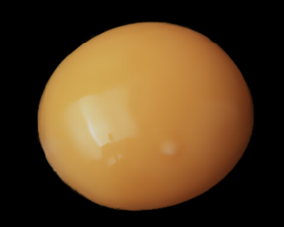
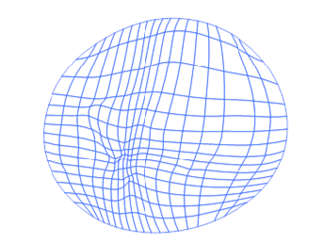
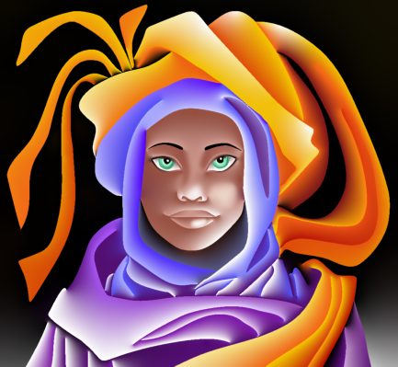
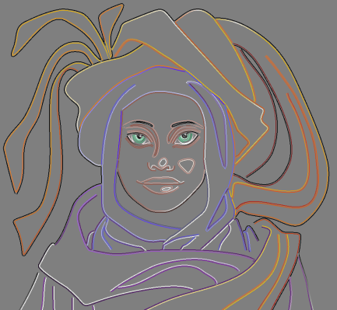
Image Vectorization
Convert a raster image into a vector graphics
Vector primitives: points, curves, meshes
Compact, resolution-independent
Input and vector primitives [Sun et al. 07;Orzan et al. 08]
Notes:
Image vectorization is to convert a raster image into a vector graphics.
Vector graphics uses vector primitives to represent the image, such as points, curves and meshes.
It is a compact and resolution-independent representation.

Slide 3
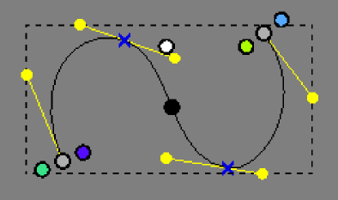
Diffusion Curves
Definition [Orzan et al. 08]
Color defined on control curves
Non-zero Laplacian on the curves and zero Laplacian elsewhere
Smooth shading
Advantage
Sparse control curves
Rich shading variations
Non-zero Laplacian
Zero Laplacian
Notes:
A diffusion curve image is a powerful vector graphics representation. By defining colors along a sparse set of control curves,
[click] and enforcing non-zero Laplacian values on the curves and zero Laplacian values elsewhere,
[click] the diffusion curve image generates a smooth shaded image between the curves by solving a Poisson diffusion equation.
[click] As with other vector graphics models, diffusion curves have a compact representation
and provide resolution independent sharp boundaries as well as rich and smooth shading variations.

Slide 4
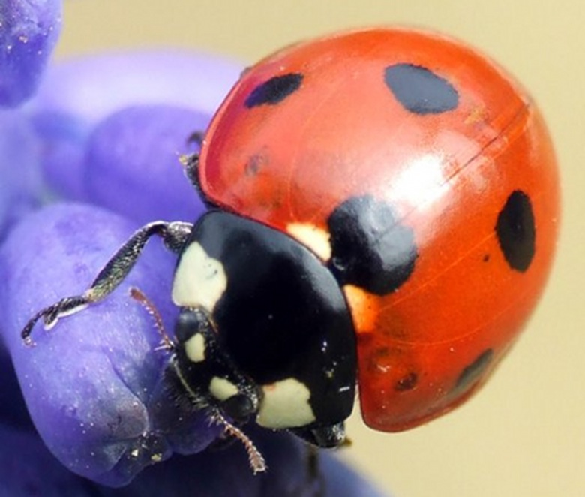
Vectorization with Diffusion Curves
High quality reconstruction
Sharp edges
Smooth variations
Automatic extraction
Smooth variation
Sharp edge
Notes:
Our work is to convert arbitrary raster images to diffusion curves.
[click] Especially for natural images, they usually have rich content,
[click] not only including sharp features,
[click] but also including smooth variations. How to perform high quality reconstruction for natural images remains a difficult problem.
[click] Another problem is how to fully automatically extract curves to reduce the workload of content creation.

Slide 5
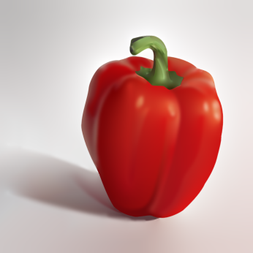
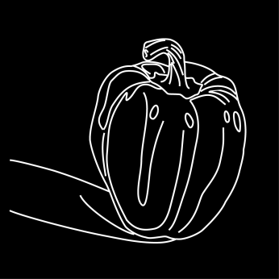
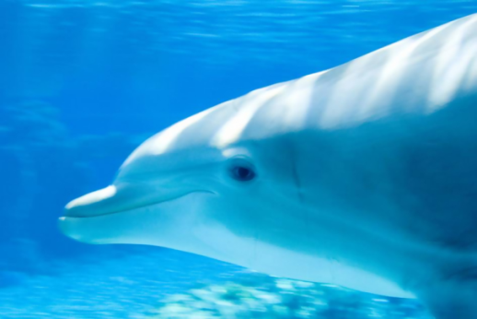
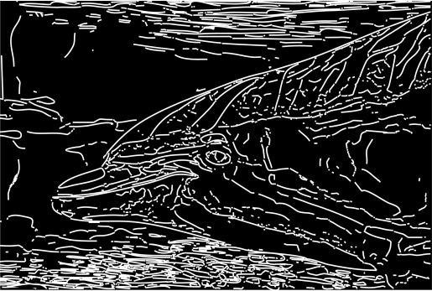
Previous Work
Manual extraction
[Orzan et al. 08; Jeschke et al. 11; Finch et al. 11; Sun et al. 12; Ilbery et al. 13; Sun et al. 14]
Automatic extraction in the gradient domain
[Orzan et al. 07; Orzan et al. 08; Jeschke et al. 11]
Hard to extract curves for smooth variations
Manual extraction
Automatic extraction
Notes:
Previous approaches use manual extraction or automatic extraction, like edge detection, to trace curves in the gradient domain. It works for sharp image features. However, for blurred edges or smooth variations, it is difficult to extract curves.

Slide 6
Our Contribution
Accurate automatic image vectorization
Hierarchical diffusion curve representation
Laplacian and bilaplacian diffusion curves
Notes:
To address these problems, we propose an accurate and automatic method to vectorize images. We propose hierarchical diffusion curves to represent multi-scale image features.
Meanwhile, we classify Laplacian and bilaplacian diffusion curves to improve reconstruction quality.

Slide 7
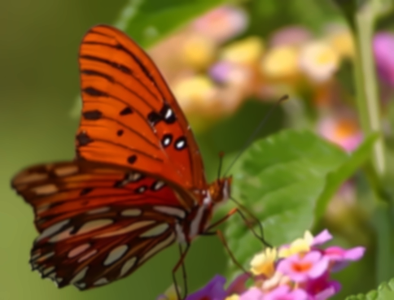
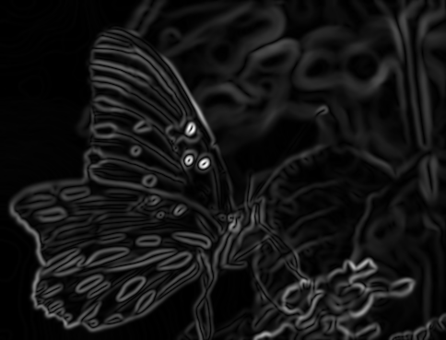
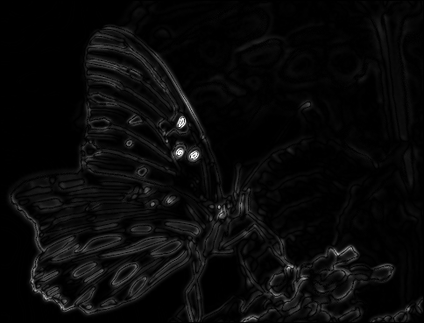
Key Idea
Trace curves in the Laplacian domain instead of gradient domain
Capture both sharp and smooth image features
Input
Gradient domain
Laplacian domain
Notes:
The key idea of our method is to trace curves in the Laplacian domain instead of gradient domain, which captures both sharp and smooth image features.
[click] Here are the results of the gradient domain and Laplacian domain, which are different.

Slide 8
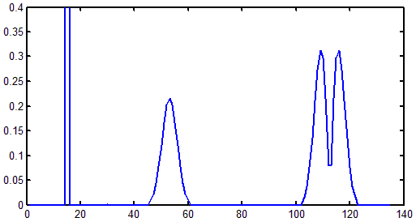
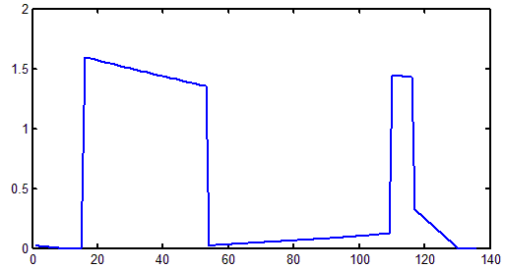
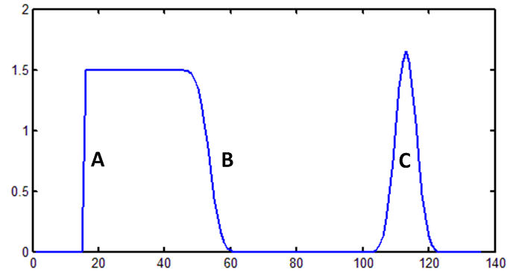
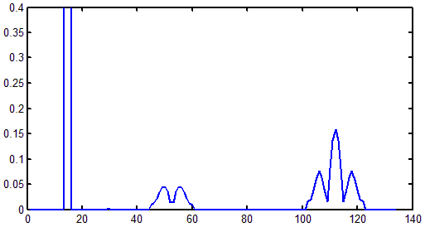
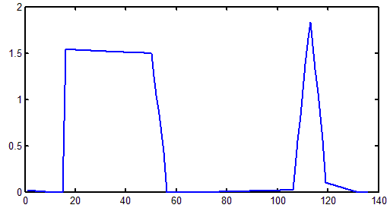
Curve Extraction (1D)
Sharp
Bump
Gradient domain
Reconstruction
Blurred
Laplacian domain
Reconstruction
Notes:
We show our choice for fitting curves in the Laplacian domain, comparing against gradient domain using a simple 1D example.
[click] Many images not only include sharp edges, but also include blurred edges and regions with variations.
[click] Previous diffusion curve fitting approaches extract curves in the image domain using edge detection, effectively fitting curve structures to local maxima in the gradient domain.
[click] For sharp edges, significant Laplacian values overlap large gradient values. Therefore, in this case, gradient domain methods accurately detect and place curves in meaningful regions.
[click] However, for blurred edges or smooth image variations, maxima in the gradient domain do not overlap with significant Laplacian value. As a result, gradient domain methods end up placing curves away from regions with significant Laplacian values. Without accurate curve placement in these regions, the resulting diffusion curve image reconstruction cannot properly capture these smooth image variations. Accurately detecting regions of smooth image variation, or with very blurred edges, in the gradient domain is very difficult.
[click] Our Laplacian domain algorithm, on the other hand, directly detects these regions with significant Laplacian values, including those associated with both sharp edges and blurred edges, as well as the types of variations. With accurately placed curves, our method faithfully reconstructs the input image.

Slide 9
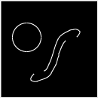
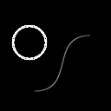
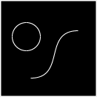
Curve Extraction (2D)
Gradient
Recon.
Diff. (16X)
Input
Laplacian
Recon.
Diff. (16X)
Notes:
We illustrate another simple example in 2D.
Given an input image, which contains both a sharp circular edge and a blurred edge defined along an “S”-shaped profile,
[click] While the circular edge is clearly identified by a gradient domain edge detector,
[click] only the Laplacian transform is capable of identifying the large Laplacian values of both features.
[click] Our Laplacian domain approach successfully extracts these features and sets the values
[click] We can achieve a more accurate reconstruction than the results generated by the gradient domain approach.

Slide 10
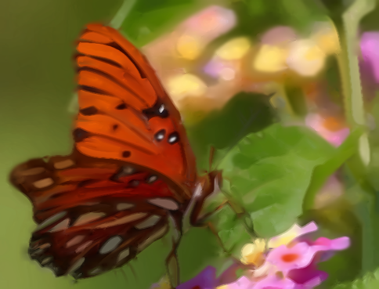
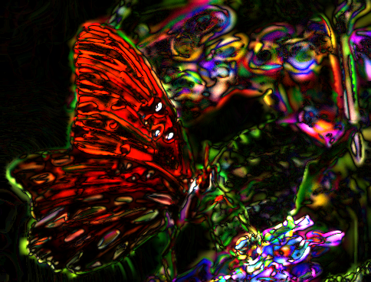
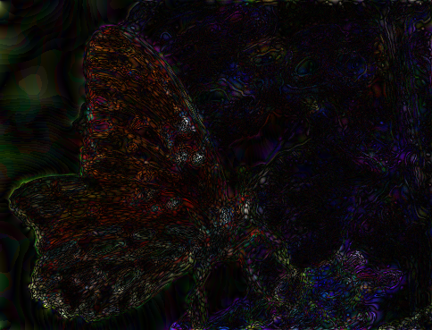
One Result
Input
Gradient recon.
Laplacian recon.
Diff. (8X)
Diff. (8X)
Notes:
We show one natural image result. Given an input image,
[click] we compare the reconstruction results,
[click] our result error is lower than gradient method.

Slide 11
Outline
Curve extraction in the Laplacian domain
Hierarchical curve construction
Laplacian/bilaplacian diffusion curves
Notes:
I will introduce our algorithm from three sections, including curve extraction in the Laplacian domain, hierarchical curve construction, and Laplacian/bilaplacian diffusion curves.

Slide 12
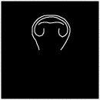
Curve Extraction in the Laplacian Domain
Input
n⊥
n
Laplacian
Direction
Curve pixels
Curves
Fitting
[Sun et al. 12; Ilbery et al. 13]
$$u\left(x\right)= \oint_{∂D}{(\frac{∂u\left(x^{′}\right)}{∂n\left(x^{′}\right)}G^{L}\left(x,x^{′}\right) −u(x^{′})\frac{∂G^{L}(x, { x}^{′})}{∂n\left(x^{′}\right)})}dx^{′}$$ $+ \oint_{∂D}{(\frac{∂v\left(x^{′}\right)}{∂n\left(x^{′}\right)}G^{B}\left(x,x^{′}\right) −v(x^{′})\frac{∂G^{B}(x, { x}^{′})}{∂n\left(x^{′}\right)})}dx^{′}$
Approximate second partial derivatives of the image Laplacian
Non-maximal suppression
Recon.
Notes:
In the image Laplacian domain, we first identify curve pixels, and then connect them to form curves.
For example, given an input image,
[click] We compute the image Laplacian,
[click] then estimate curve directions locally at each image pixel
[click] and use non-maximal suppression kernel to compute the local maxima and form candidate curve pixels.
[click] We connect these curve pixels along the tangent direction of pixels to form curves.
[click] After extracting curves, we fit the Laplacian diffusion endpoint weights using a unified formulation, based on Green’s functions.
[click] In this way, we can reconstruct the image from these diffusion curves.

Slide 13
Hierarchical Representation
Multi-scale features
Long curves represent large scale features, while shorter curves represent smaller details
Notes:
Furthermore, we propose a hierarchical curve structure to represent multi-scale features.
Long curves represent large scale image features, while shorter curves represent smaller scale details.

Slide 14
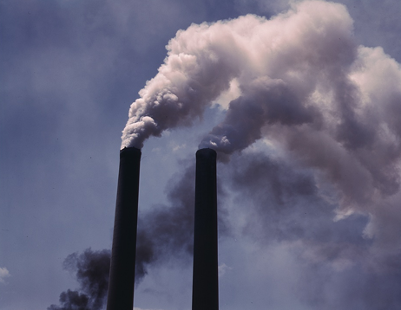
Hierarchical Curve Construction
Multi-scale bilateral decomposition
Structure-preserving
$$u^{j+1}[p]=1/k\sum_{q∈Ω_{j}}{g_{σ_{s,j}}(\left\|q\right\|)g_{σ_{r,j}}(u^{j}\left[p+q\right]−u^{j}[p])u^{j}[p+q]}$$
Input
Scale 0
Scale 1
Scale 2
Notes:
We use structure-preserving multi-scale bilateral filtering to blur the input image into a stack of filtered images.
[click] According to the scale, we set different spatial filter width and range filter width to get each scale’s image.

Slide 15
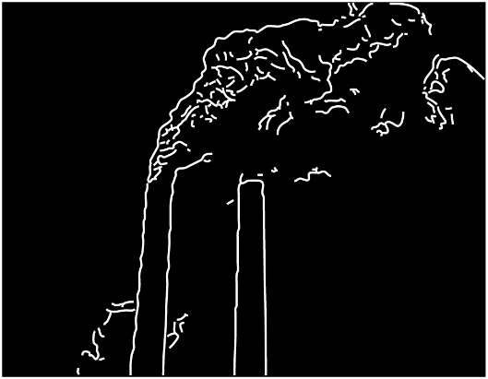
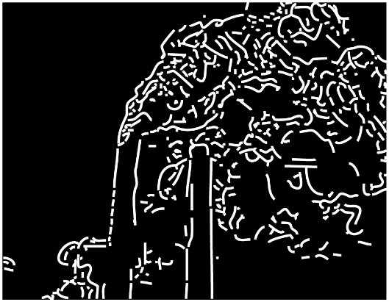
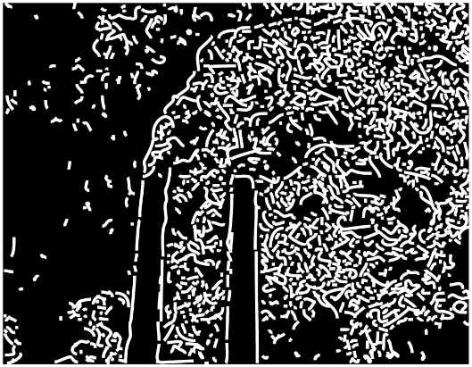
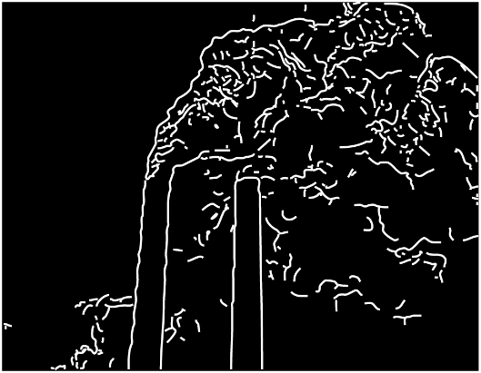
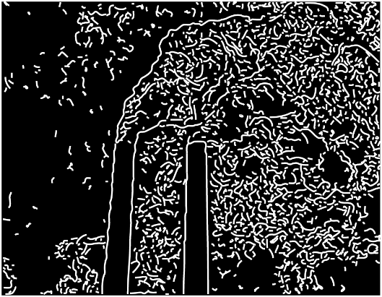
Hierarchical Curve Construction
Extraction
Overlapping
Construction
Notes:
After bilateral filtering,
[click] curves are extracted at each scale in the image Laplacian domain.
[click] then, to preserve large-scale image features, curves are constructed from the coarsest scale first. For finer scale, we remove overlapping regions with all coarsest curves as curves of the scale.
[click] After achieving the curves in all scales, we can construct a hierarchical curve structure.

Slide 16
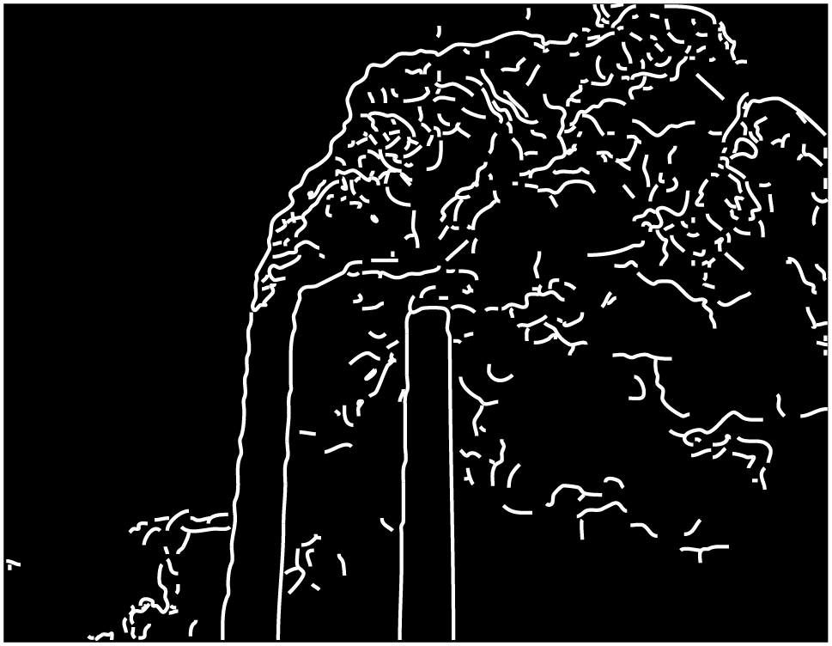
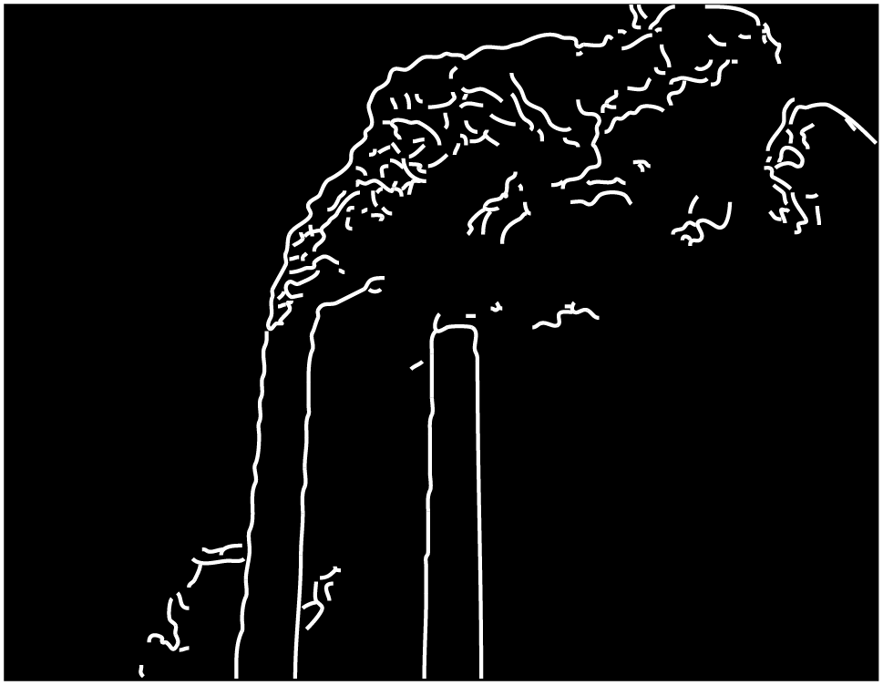
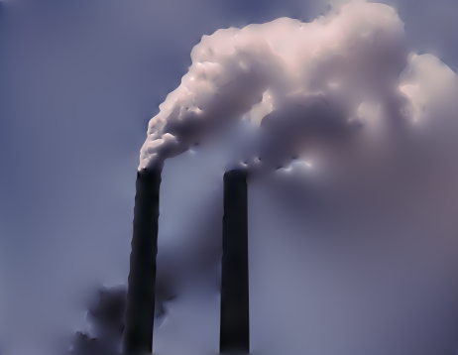
Application – Multi-scale Abstraction
Curves 2
Curves 1+2
Curves 0+1+2
Scale 2
Scale 1+2
Scale 0+1+2
Notes:
According to our hierarchical representation, we can perform simple but powerful image manipulation, including detail removal and multi-scale shape abstraction.
For example, finest scale more faithfully represents the input image,
[click] As the removal of small features, coarser scale provides a higher level of abstraction.
[click] and more higher abstraction.

Slide 17
Application – Multi-scale Abstraction
Scale 0+1+2
Scale 1+2
Scale 2
Notes:
These are abstraction results in different scales.

Slide 18
Bilaplacian Diffusion Curves
Curves in the image bilaplacian domain
Bilaplacian: higher order smooth variations [Ilbery et al. 13]
Input
Curves
Recon.
Notes:
We also extend our method to bilaplacian, tracing diffusion curves in the image bilaplacian domain.
Bilaplacian can capture sharp and higher order smooth image variations. This type of image features often appear in natural images and fluid simulations.

Slide 19
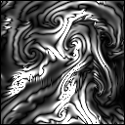
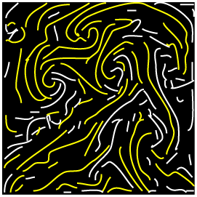
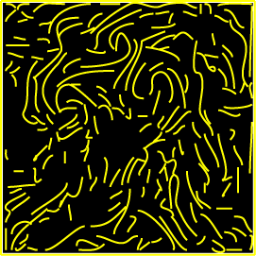
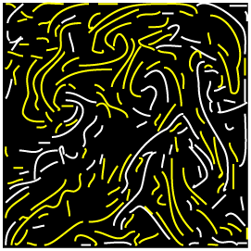
Lap./bilap. Diffusion Curves
Input
Lap. Curves
Laplacian
Bilaplacian
Bilap. Curves
Lap. + bilap. Curves
Notes:
Due to high computation cost of bilaplacian, we combine Laplacian and bilaplacian diffusion curves to represent the image.
Given an input image,
[click] we compute the Laplacian and bilaplacian domain,
[click] and extract curves respectively.
[click] Then, we use a voting scheme to classify each curve as a Laplacian or bilaplacian curve. For sharp features, we prefer Laplacian curves. For higher smooth variations, we use bilaplacian curves. For detailed classification algorithm, please refer to our paper.

Slide 20
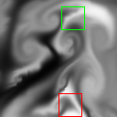
Lap./bilap. Diffusion Curves
Lap.
Bilap.
Input
Lap. + bilap.
Zoom-in
Notes:
If only using Laplacian curves, the color discontinuity along the curves presents a very high color variation.
[click] If we apply bilaplacian-only curves, the discontinuity disappears.
[click] Combining Laplacian and bilaplacian curves is a tradeoff between performance and quality.

Slide 21
Implementation Details
An Intel Core i7-3770K 3.5 GHz CPU and an Nvidia Quadro 6000
Number of Bezier curves: 42 ~ 45K
Storage: 36KBytes ~ 363KBytes
Fitting: 21.9s ~ 660s
Performance: 40.8ms ~ 591ms
Notes:
We implemented our algorithm on GPU.
The curves are up to 45 thousand curves, which only need 4 hundred Kilo bytes storage.
It can still be rendered in interactive speed.

Slide 22
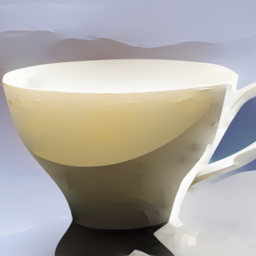
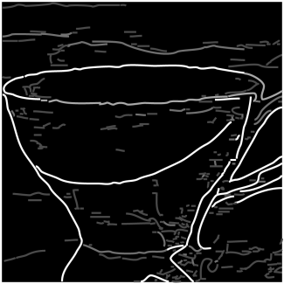
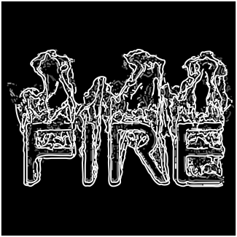
Results
Notes:
We are able to accurately vectorize raster images by automatically a sparse set of multi-scale diffusion curves to a broad class of images, including vector art, computer synthesized turbulent simulations.

Slide 23
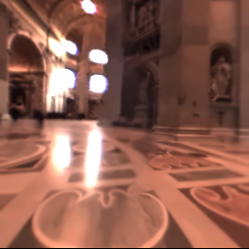
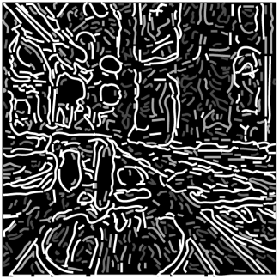
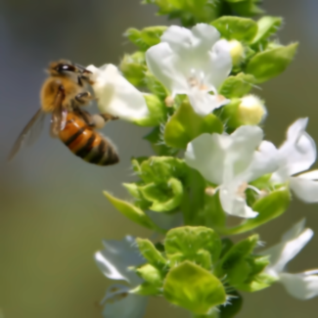
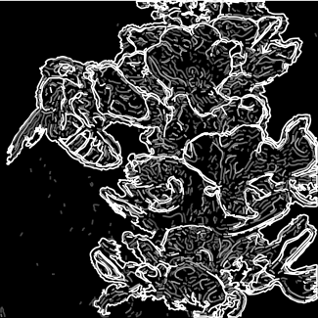
Results
Notes:
and natural images.

Slide 24
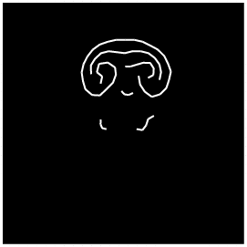
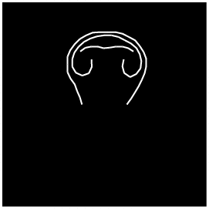
Comparison: Gradient vs. Laplacian
Gradient
Recon.
Diff. (8X)
Input
Laplacian
Recon.
Diff. (8X)
Notes:
Here we compare gradient domain approach and our Laplacian domain approach.
[click] when using almost the same number of curves,
[click] we reconstruct the results.
[click] gradient approach does not accurately capture the important image features, the reconstruction result with these curves has high errors whereas our result using Laplacian diffusion curves, shows significant improvement.

Slide 25
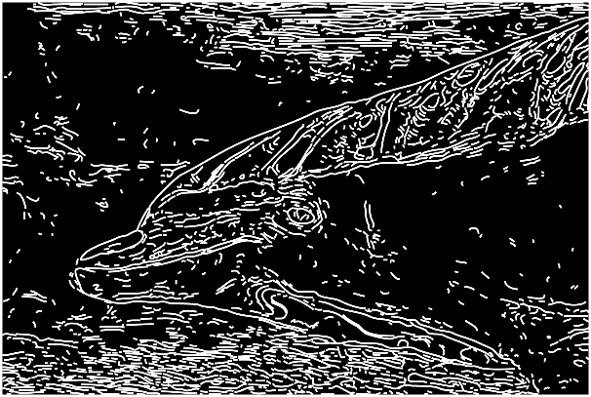
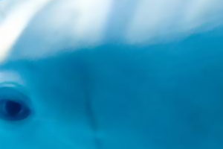
Comparison with [Orzan et al. 08]
Input
Gradient curves
Our curves
Without blur
With blur
Our result
Notes:
Here, we reconstruct a smoother result that is closer to the original image, while gradient method reconstructs sharp boundaries without blurring.
[click] In order to generate smoother results, the method needs to apply an expensive post-processing blur.

Slide 26
Comparison: FFG
Freeform vector graphics
Ours
Notes:
We can also automatically fit curves, including Laplacain and bilaplacian curves, to a freeform vector graphics reconstruction. Our curves are similar with FFG’s sketched curves and our reconstruction retains both the sharp image edges and the smooth color variations by using Laplacian and bilaplacian diffusion curves.

Slide 27
Hierarchical Representation and Abstraction
Input
Curves
Scale 2
Scale 1
Scale 0
Notes:
This illustrates how our multi-scale curves can readily be used for image abstraction.
[click] the coarsest scale reconstruction preserves large-scale features, such as the head and jacket, while finer scales progressively re-introduce the small-scale details.

Slide 28
Editing
Edit
Input
Curves
Reconstruction
Notes:
This is a simple editing result. Given an input image,
[click] we first extract Laplacian diffusion curves and color profiles.
[click] In order to edit the image, we can change the colors defined on the curves and
[click] regenerate the result without refitting the curve endpoint weights.

Slide 29
More Results
Notes:
This illustrates our multi-scale curves and reconstruction results for complex natural images and a turbulent computer synthesized simulation result. Our results clearly reconstruct both the coarse- and fine-scale details of these challenging images.

Slide 30
Conclusion
Accurate and fully automatic method
Vectorize images using diffusion curve representation
Extract curves in the Laplacian/bilaplacian domain
Propose hierarchical fitting and multi-scale representation
Notes:
In conclusion, we present a robust and fully-automatic method to vectorize images using a hybrid, sparse diffusion curve representation.
We leverage a fundamental observation that extracting curves in the Laplacian/bilaplacian domain along local maxima.
Meanwhile, we propose a hierarchical representation to present a LOD.

Slide 31
Limitations and Future Work
Limitations
Remove image features with low contrast
Generate many short curves for noisy images
Future work
3D volume vectorization
Animation sequences
Notes:
Here we point out our limitations and some possible directions for future work:
The limitations are that the multi-scale bilateral filter may remove image features with low contrast. And when vectorizing noisy natural images, our algorithm may generate many short curves.
For future work, one direction is to extend our method to 3D volume vectorization.
Another is to vectorize animation sequences.

Slide 32
Acknowledgements
Anonymous reviewers
Valuable suggestions and comments
Adrien Bousseau
Share the implementation of [Orzan et al. 08]
Pierre Poulin and Stephen Lin for proofreading
Funding
NSERC and MITACS with Microsoft Game Studios
NSF of China (61379087)
Notes:
We would like to thank many people for their valuable help in this paper.

Slide 33
Thank you!
Notes:
Thank you for your attention.

Slide 34
Comparison:
Input
Curves
Curves
Col. Recon.
Our Recon.
Our Recon.
Close-up
Close-up
Close-up
Notes:
We also compare different fitting methods.
[click] Given the same curves, we can reconstruct a similar result.
[click] Curves of some features which are difficult to manually extract can be automatically extracted by our method, like the tail and dorsal fin of the fish.

