Slide 1
The Algorithmics of Probabilistic Automata Weak Bisimulation
Andrea Turrini
Saarland University
based on a joint work with
Holger Hermanns

Slide 2
Probabilistic Automata (PA)
s
coin
coin
f
u
flip
retry
flip
flip
8/16
8/16
12/16
4/16
h_{f}
t_{f}
t_{u}
h_{u}
n
sms
sms
sms
sms
sms
beep_{f}
flash_{f}
flash_{u}
beep_{u}
vibrate

Slide 3
Probabilistic Automata (PA)
PA = (Q, q₀, E, H, D)
Transition relation
D ⊆ Q × (E ) × (Q)
∪ H
→
Disc
Internal (hidden) actions
External actions: E ∩ H = ∅
Initial state: q₀ ∈ Q
States

Slide 4
Weak bisimulation
Weak bisimulation between A₁ and A₂
Equiv. Rel. R ⊆ Q × Q
Q = Q₁ ∪ Q₂, such that
∀ s, t, a, ∃
m
r
s
a
m
+
R
R
s₀
a
τ
τ
t
r
p
1-p
s₁
s₂
t₁
μ R ρ
[JL91]
b
b
b
⇔
s₃
s₄
t₃
∀C ∈ Q/R . μ (C) = ρ (C)

Slide 5
Usual decision procedure
Bisimulation(A₁, A₂)
W := {Q₁ ∪ Q₂}
(C, α) := FindSplit(W)
while C ≠ ∅ do
W := Refine(W, α, C)
(C, α) := FindSplit(W)
return W
FindSplit(W)
for each (s, α, ) ∈ D₁ ∪ D₂
for each t ∈ [s]_{W}
if there does not exist such that t and W return ([s]_{W}, α)
return (∅, α)
+
N
m
+
N
N
r
α
r
m
r
N = max (| D₁ ∪ D₂ |, | Q₁ ∪ Q₂ |)
+
+

Slide 6
Weak transition
s
coin
coin
f
u
flip
retry
flip
flip
8/16
8/16
12/16
4/16
h_{f}
t_{f}
t_{u}
h_{u}
n
sms
sms
sms
sms
sms
beep_{f}
flash_{f}
flash_{u}
beep_{u}
vibrate
{beep: 5/16, flash: 7/16, vibrate: 4/16}
{beep: 2/16, flash: 2/16, vibrate: 12/16}

Slide 7
How many weak transitions?
τ
τ
τ
τ
τ
τ
τ
τ
τ
τ
C₀₀: bbbbb
C₀₁: bbbbt
C₀₂: bbbtb
C₃₀: ttttb
C₃₁: ttttt

Slide 8
Weak transition as Flow
s
coin
coin
f
u
flip
retry
flip
flip
8/16
8/16
12/16
4/16
h_{f}
t_{f}
t_{u}
h_{u}
n
sms
sms
sms
sms
sms
beep_{f}
flash_{f}
flash_{u}
beep_{u}
vibrate
{beep: 5/16, flash: 7/16, vibrate: 4/16}

Slide 9
Weak transition vs. Flow Problem
s
coin
coin
16/16
f
16/16
16/16
u
flip
retry
flip
flip
8/16
8/16
12/16
4/16
16/16
h_{f}
t_{f}
t_{u}
h_{u}
n
sms
sms
sms
sms
sms
16/16
16/16
16/16
16/16
16/16
beep_{f}
flash_{f}
flash_{u}
beep_{u}
vibrate
{beep: 0/16, flash: 16/16, vibrate: 0/16}

Slide 10
Flow as Linear Programming Problem
min Σ f_{i}
under constraints
1
f₀
f₁
s
f₄
8/16
8/16
0 ≤ f_{i} ≤ c_{i} (< ∞)
f₀ + f₈ = f₁ + f₄
f₁ = f₂ + f₃
f₂ = f₉
f₃ = f₁₀
f₄ = f₅ + f₆ + f₇
f₅ = f₈ + f₁₁
f₆ = f₁₂
f₇ = f₁₃
f
u
4/16
4/16
0
3/16
4/16
f₂
f₃
f₈
f₅
f₆
f₇
1/16
8/16
8/16
12/16
4/16
h_{f}
t_{f}
t_{u}
h_{u}
n
Polynomial!
4/16
4/16
3/16
1/16
4/16
f₉
f₁₀
f₁₁
f₁₂
f₁₃
beep_{f}
flash_{f}
flash_{u}
beep_{u}
vibrate
✓
f₀ = 1
f₉ + f₁₂ = 5/16
f₁₀ + f₁₁ = 7/16
f₁₃ = 4/16
f₂ = 8/16(f₂ + f₃)
f₃ = 8/16(f₂ + f₃)
f₅ = 12/16(f₅ + f₆)
f₆ = 4/16(f₅ + f₆)
{beep: 5/16, flash: 7/16, vibrate: 4/16}
s
Complexity:
#variables ∈ O(|Q|⋅|D|)
#constraints ∈ O(|Q|⋅|D|)
beep
flash
vibrate

Slide 11
Usual decision procedure
Bisimulation(A₁, A₂)
W := {Q₁ ∪ Q₂}
(C, α) := FindSplit(W)
while C ≠ ∅ do
W := Refine(W, α, C)
(C, α) := FindSplit(W)
return W
FindSplit(W)
for each (s, α, μ) ∈ D₁ ∪ D₂
for each t ∈ [s]_{W}
if there does not exist ρ such that t ρ and μ W ρ return ([s]_{W}, α)
return (∅, α)
+
N
+
N
N
Polynomial
α
Polynomial!
N = max (| D₁ ∪ D₂ |, | Q₁ ∪ Q₂ |)
+
+

Slide 12
From bisimulation to minimal automaton
A = (Q, q₀, E, H, D)
zeroconf-nt: |Q| = 670, |D| = 827
Quotienting
QA = (W, [q₀]_{W}, E, H, D_{W})
zeroconf-nt: |W| = 41, |D_{W}| = 55
Transition reduction
mA = (W, [q₀]_{W}, E, H, D_{W})
zeroconf-nt: |W| = 41, |D_{W}| = 52

Slide 13
Adding costs to PA
c
s
d
1
1
t_{r}
t_{r}
…
t_{r}
t_{r}
h₀
h₁
h_{n-1}
h_{n}
p
p
p
p
1-p
r²
1-p
r²
1-p
r²
1-p
r²
C(csh₀) = 1 x 1
C(h₀t_{r}h₁) = r² x p
C(h₀t_{r}h₀t_{r}h₁) = (r² + r²) x (1-p) x p
r² / p
C(h₀t_{r}h₀t_{r}h₀t_{r}h₁) = (r² + r² + r²) x (1-p) x (1-p) x p
C((h₀t_{r})^{i}h₁) = (i + 1) x r² x (1-p)^{i} x p
Overall cost: 1 + nr²/p + 1

Slide 14
Adding costs to PA
c
s
d
1
1
t_{r}
t_{r}
…
t_{r}
t_{r}
h₀
h₁
h_{n-1}
h_{n}
p
p
p
p
1-p
r²
1-p
r²
1-p
r²
1-p
r²
Polynomial!
0
1
c
1
1
r²
r²
…
r²
r²
h₀
h₁
h_{n-1}
h_{n}
1
p
1
p
1
p
1
p
1
1-p
r²
1-p
r²
1-p
r²
1-p
r²
1
(1-p) / p
(1-p) / p
(1-p) / p
(1-p) / p
c
0
1
Minimum cost equals optimal LP solution

Slide 15
Nondeterminism and Cost PA
c
s
d
1
1
t₅
t₅
h₂
t₅
t₅
h₀
h₁
h₃
h₄
p
p
p
p
1-p
5²
1-p
5²
1-p
5²
1-p
5²
0
o
o
o
o
0
0
0
t₄
q₂
t₄
t₄
t₄
q₁
q₃
q₄
q₅
p
p
p
p
1-p
4²
1-p
4²
1-p
4²
1-p
4²
2 + 89/p ≤ cost ≤ 2 + 100/p

Slide 16
Comparing Cost PA
c
s
d
≥ 2 + 89/p
1
1
t₅
t₅
h₂
t₅
t₅
h₀
h₁
h₃
h₄
p
p
p
p
1-p
5²
1-p
5²
1-p
5²
1-p
5²
0
o
o
o
o
0
0
0
t₄
q₂
t₄
t₄
t₄
q₁
q₃
q₄
q₅
p
p
p
p
1-p
4²
1-p
4²
1-p
4²
1-p
4²
w
s
d
2 + 80/p
1
1
t₄
t₄
k₂
t₄
t₄
t₄
k₀
k₁
k₃
k₄
k₅
p
p
p
p
p
1-p
4²
1-p
4²
1-p
4²
1-p
4²
1-p
4²

Slide 17
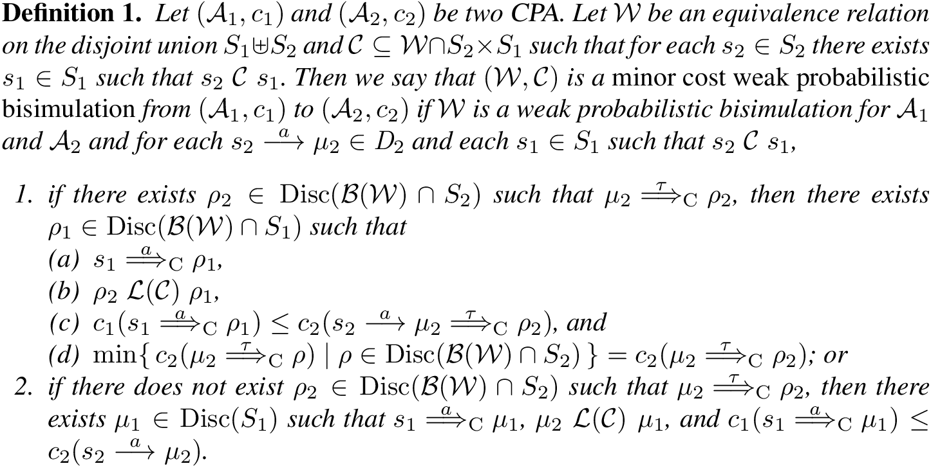
Minor Cost Weak Bisimulation

Slide 18
Comparing Cost PA
c
s
d
≥ 2 + 89/p
1
1
t₅
t₅
h₂
t₅
t₅
h₀
h₁
h₃
h₄
p
p
p
p
1-p
5²
1-p
5²
1-p
5²
1-p
5²
0
o
o
o
o
0
0
0
t₄
q₂
t₄
t₄
t₄
q₁
q₃
q₄
q₅
p
p
p
p
1-p
4²
1-p
4²
1-p
4²
1-p
4²
w
s
d
2 + 80/p
1
1
t₄
t₄
k₂
t₄
t₄
t₄
k₀
k₁
k₃
k₄
k₅
p
p
p
p
p
1-p
4²
1-p
4²
1-p
4²
1-p
4²
1-p
4²

Slide 19
Conclusion
Weak transitions as LP problems
Polynomial decision procedure for PA weak probabilistic bisimulation
Minimal automaton
Cost decorated PA
Prototypical implementation
Extensions of LP approach
Specific weak transitions, hyper-transitions,
restricted transitions, equivalence matching, …
MDP multi-objective reachability
Interval multi-objective reachability
Multi-objective reachability in interval models
Base for other models: Markov Automata

Slide 20
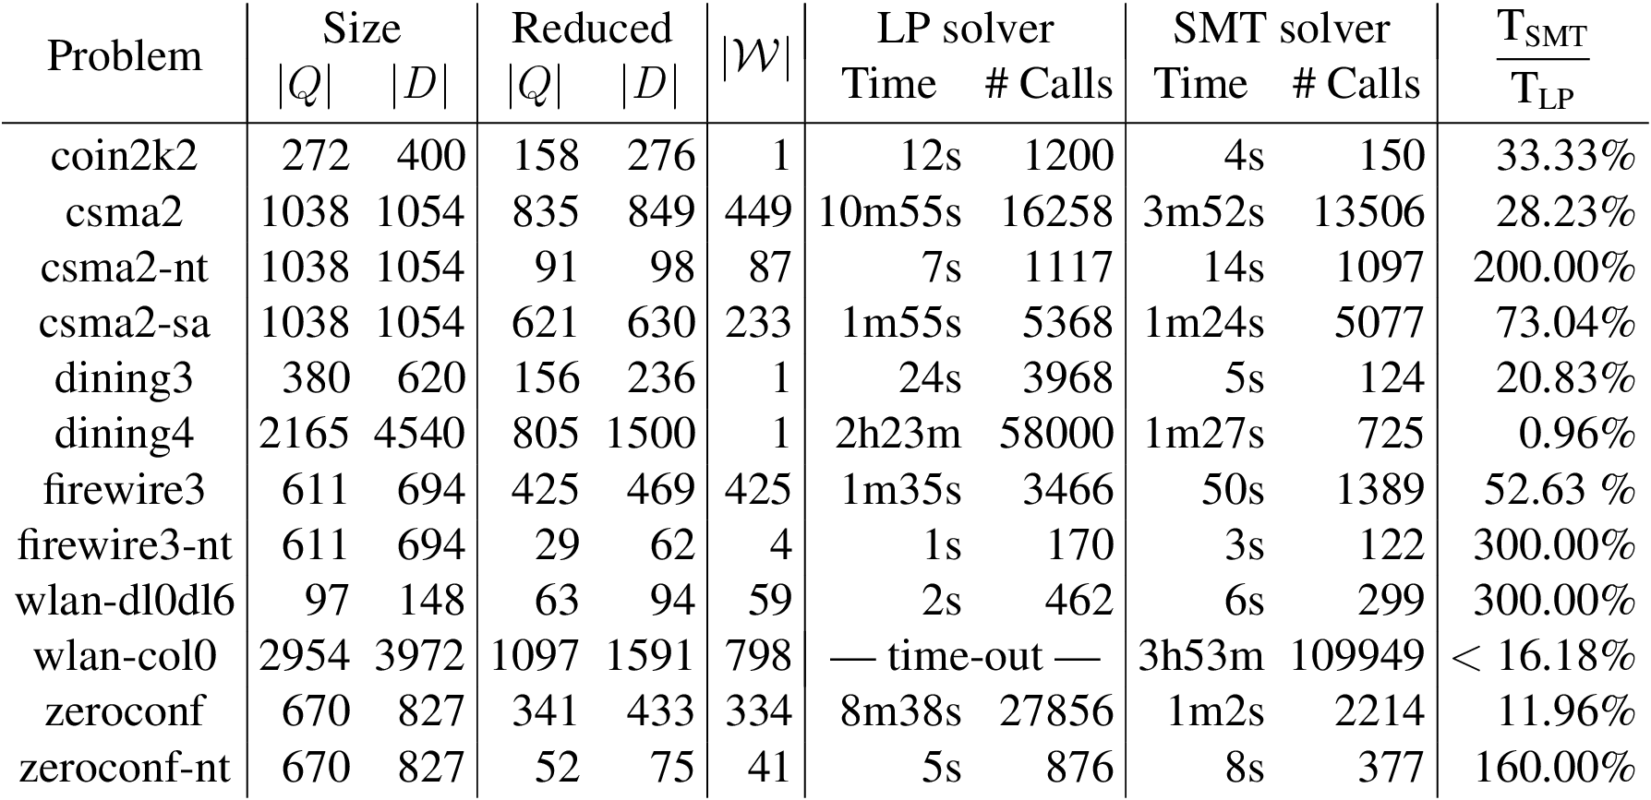
Decision procedure in practice

Slide 21
Usual decision procedure
Bisimulation(A₁, A₂)
W := {Q₁ ∪ Q₂}
(C, α) := FindSplit(W)
while C ≠ ∅ do
W := Refine(W, α, C)
(C, α) := FindSplit(W)
return W
FindSplit(W)
for each (s, α, ) ∈ D₁ ∪ D₂
for each t ∈ [s]_{W}
if there does not exist such that t and W return ([s]_{W}, α)
return (∅, α)
+
N
m
+
N
N
r
α
r
m
r
N = max (| D₁ ∪ D₂ |, | Q₁ ∪ Q₂ |)
+
+

Slide 22
How many weak transitions?
s
coin
coin
f
u
flip
retry
flip
flip
8/16
8/16
12/16
4/16
h_{f}
t_{f}
t_{u}
h_{u}
n
sms
sms
sms
sms
sms
beep_{f}
flash_{f}
flash_{u}
beep_{u}
vibrate

Slide 23
How many weak transitions?
τ
τ
τ
τ
τ
τ
τ
τ
τ
τ
C₀₀: bbbbb
C₀₁: bbbbt
C₀₂: bbbtb
C₃₀: ttttb
C₃₁: ttttt

Slide 24
Usual decision procedure
Bisimulation(A₁, A₂)
W := {Q₁ ∪ Q₂}
(C, α) := FindSplit(W)
while C ≠ ∅ do
W := Refine(W, α, C)
(C, α) := FindSplit(W)
return W
FindSplit(W)
for each (s, α, μ) ∈ D₁ ∪ D₂
for each t ∈ [s]_{W}
if there does not exist ρ such that t ρ and μ W ρ return ([s]_{W}, α)
return (∅, α)
+
N
+
N
N
Polynomial
α
Polynomial!
N = max (| D₁ ∪ D₂ |, | Q₁ ∪ Q₂ |)
+
+

Slide 25
From bisimulation to minimal automaton
A = (Q, q₀, E, H, D)
zeroconf-nt: |Q| = 670, |D| = 827
Quotienting
QA = (W, [q₀]_{W}, E, H, D_{W})
zeroconf-nt: |W| = 41, |D_{W}| = 55
Transition reduction
mA = (W, [q₀]_{W}, E, H, D_{W})
zeroconf-nt: |W| = 41, |D_{W}| = 52

Slide 26
Weak transition as SMT problem
min Σ f_{i}
under constraints
assert
0 ≤ f_{i} ≤ c_{i} (< ∞)
f₀ + f₈ = f₁ + f₄
f₁ = f₂ + f₃
f₂ = f₉
f₃ = f₁₀
f₄ = f₅ + f₆ + f₇
f₅ = f₈ + f₁₁
f₆ = f₁₂
f₇ = f₁₃
declare-fun f_{i} () Real
assert
assert
f₀ = 1
f₉ + f₁₂ = 5/16
f₁₀ + f₁₁ = 7/16
f₁₃ = 4/16
f₂ = 8/16(f₂ + f₃)
f₃ = 8/16(f₂ + f₃)
f₅ = 12/16(f₅ + f₆)
f₆ = 4/16(f₅ + f₆)
assert
assert
assert
assert
assert
assert
assert
assert
assert
assert
assert
assert
assert
assert

