Slide 1
Antichains: A New Algorithm for Checking Universality of Finite Automata
M. De Wulf
L. Doyen
T. A. Henzinger
J. –F.Raskin

Slide 2
Introduction
Universality problem:
given an NFA A over the alphabet Σ, if the language of A contains all finite words over , that is, if Lang(A) = Σ*.

Slide 3
Introduction
Traditional method for universality problem:
determinize the automaton using the subset construction;
check for the reachability of a set containing only nonaccepting states.
The exponential explosion of subset construction is in some sense unavoidable.
The universality problem is PSpace-complete.

Slide 4
Introduction
To avoid the subset construction, they proposed a lattice-theoretic solution that comes in the form of a monotone function on the lattice of antichains of state.
The greatest fixed point of this monotone function contains the solution to the strategy synthesis problem.

Slide 5
Finite Automata
NFA: A = <Loc, Init, Fin, Σ, δ >

Slide 6
Two Lattices of Antichain
An antichain over Loc is a set q⊆2^{Loc} such that ∀s,s’∈q: s⊄s’.
Two partial orders(L is the set of antichains over Loc):
q,q’ ∈L, let q ⊑q’iff ∀s ∈q ∃s’∈q’: s⊆s’
q,q’ ∈L, let q ~⊑q’iff ∀s’ ∈q’ ∃s∈q: s⊆s’

Slide 7
Two Lattices of Antichain
Maximal and minimal
a set s ∈ q is maximal in q iff ∀s’∈q: s⊄s’ (⎡q⎤)
a set s ∈ q is minimal in q iff ∀s’∈q: s’⊄s (⎣q⎦)
Least upper bound and greatest lower bound
q ⊔ q’= ⎡{s| s∈q ∨s ∈q’} ⎤
q ⊓ q’= ⎡{s∩s’| s∈q ∧s’ ∈q’}⎤
q ~⊔ q’= ⎣{s∪s’| s∈q ∧ s’ ∈q’} ⎦
q ~⊓ q’ =⎣{s| s∈q ∨s ∈q’} ⎦

Slide 8
Two Lattices of Antichain
An example:
q={{a,b}, {a,c}} q’={{a,b,c},{b,d}}
q ⊔ q’= ⎡{s| s∈q ∨s ∈q’} ⎤
= ⎡{{a,b},{a,c},{a,b,c},{b,d}} ⎤
={{a,b,c},{b,d}}
q ⊑ q ⊔ q’, q’ ⊑ q ⊔ q’
q ⊓ q’= ⎡{s∩s’| s∈q ∧s’ ∈q’}⎤
= ⎡{ {a,b} ∩{a,b,c}, {a,b} ∩{b,d}, {a,c} ∩{a,b,c}, {a,c} ∩{b,d} }⎤
= ⎡{ {a,b}, {b},{a,c} }⎤
={{a,b}, {a,c}}
q ⊓ q’ ⊑q, q ⊓ q’ ⊑q’

Slide 9
Two Lattices of Antichain
q={{a,b}, {a,c}} q’={{a,b,c},{b,d}}
q ~⊔ q’=⎣{s∪s’| s∈q ∧ s’ ∈q’} ⎦
=⎣{ {a,b} ∪{a,b,c}, {a,b} ∪{b,d}, {a,c} ∪{a,b,c}, {a,c} ∪{b,d} } ⎦
= ⎣{ {a,b,c}, {a,b,d},{a,b,c},{a,b,c,d}} ⎦
={ {a,b,c}, {a,b,d}}
q ~⊑ q ~⊔ q’ q’ ~⊑ q ~⊔ q’
q ~⊓ q’ =⎣{s| s∈q ∨s ∈q’} ⎦
=⎣{{a,b}, {a,c},{a,b,c},{b,d}} ⎦
={{a,b},{a,c},{b,d}}
q ~⊓ q’ ~⊑ q q ~⊓ q’ ~⊑ q’

Slide 10
Two Lattices of Antichain
Lemma1 <L, ⊑ , ⊔ , ⊓ ,φ,{Loc}> and <L, ~⊑ , ~⊔ , ~⊓ ,{φ}, φ > are complete lattices.

Slide 11
Game Interpretation of Universality
A Game played by a protagonist and antagonist:
Protagonist wants to establish that a given NFA A does not accept the language Σ*.
The protagonist has to provide a finite word w such that, no matter which run of A over w the antagonist chooses, the run does not end in an accepting state.

Slide 12
Game Interpretation of Universality
A multi-round game interpretation:
In each round, the protagonist provides a single letter σ, and the antagonist decides how to update the state of A on input according to the nondeterministic transition relation.
A game of imperfect information: the protagonist must not be able to observe the state of the automaton, which is chosen by the antagonist

Slide 13
Game Interpretation of Universality
The universality problem can be solved by looking for the existence of winning strategies in such games.
The games can be solved by computing a least fixed point on the lattices.

Slide 14
A Fixed Point to Solve Universality
CPre^{A}(q)= ⎡{s|∃s’∈q ∃σ∈∑: s=cpre_{σ}^{A}(s’)} ⎤
cpre_{σ}^{A}(s)={l∈Loc| ∀l’ ∈Loc: δ(l, σ,l’)→l’∈s}
Theorem2 Let A = <Loc, Init, Fin, Σ, δ > be an NFA, and let F=∏{q| q=CPre^{A}(q) ⊔{Fin}}. Then Lang(A)≠∑*, iff {Init} ⊑F.

Slide 15
A Fixed Point to Solve Universality
An example:
q₀={Fin}={{l_{k}}}
q₁=Cpre^{A}(q₀) ⊔{Fin}={{l_{k-1} ,l_{k} }} ⊔{{l_{k}}}={{l_{k-1} ,l_{k} }}
…
q_{k-1}={{l₁,…,l_{k}}}
q_{k}={{l₁,…,l_{k}}}

Slide 16
A Fixed Point to Solve Universality
q₀={Fin}={{l_{k}}}
q₁=Cpre^{A}(q₀) ⊔{Fin}={{l_{k-1} ,l_{k} }} ⊔{{l_{k}}}={{l_{k-1} ,l_{k} }}
…
q_{k-1}={{l₁,…,l_{k}}}
q_{k}={{l₀,l₁,…,l_{k}}}
q_{k+1}={{l₀,l₁,…,l_{k}}}

Slide 17
A Fixed Point to Solve Universality
Theorem2 Let A = <Loc, Init, Fin, Σ, δ > be an NFA, and let F=∏{q| q=CPre^{A}(q) ⊔{Fin}}. Then Lang(A)≠∑*, iff {Init} ⊑F.
Proof.
Only if: assume that Lang(A) is not universal.
Let w ∈∑* \ Lang(A) be a word of size |w|=n.
Consider the sequence s₀, s₁, . . . , s_{n} of state
sets such that
(1) s₀=Init
(2) s_{i}=post_{w(i)}^{A}(s_{i-1}) for all 1≤i≤n
(3) s_{n}⊆Fin

Slide 18
A Fixed Point to Solve Universality
Prove by induction on k that {s_{n−k}} ⊑ F.
k=0. s_{n}⊆{Fin} {s_{n}} ⊑ F.
Assume {s_{n−k}} ⊑ F for all 1≤k≤i-1
For σ=w(n-i+1), we have post_{σ}^{A}(s_{n-i})=s_{n-i+1}.
Therefore {s_{n-i}} ⊑CPre^{A}({s_{n-i+1}}),
{s_{n-i}} ⊑CPre^{A}(F),(by the monotonicity of CPre^{A} and the induction hypothesis)
{s_{n-i}} ⊑CPre^{A}(F)⊔{Fin},
{s_{n-i}} ⊑F, (F is a fixed point)
In particular, we have {s₀} ⊑F, that is {Init} ⊑F

Slide 19
A Fixed Point to Solve Universality
If: assume that {Init} ⊑ F. We construct a word w ∉ Lang(A).
Consider the infinite sequence q₀, q₁, q₂, . . . of antichains defined by
(1)q₀=φ
(2)q_{i}=CPre^{A}(q_{i-1}) ⊔{Fin} for all i>0
By Tarski’s fixed point theorem, we know that F = q_{n} for some n∈N.

Slide 20
A Fixed Point to Solve Universality
We construct an integer k < n, a sequence s₀, s₁, . . . , s_{k} of k + 1 state sets, and a word w of size k such that {s_{i}} ⊑CPre^{A}(q_{n-i-1}) and post_{w(i+1)}^{A}(s_{i})⊆s_{i+1} for all 0≤i<k.
We start s₀=Init so that {s₀} ⊑q_{n}.
Then we have either {s₀} ⊑{Fin} or{s₀}⊑CPre^{A}(q_{n-1}).
In the first case, we stop with k=0 and w=ε.
In the second case, we continue the construction inductively.

Slide 21
A Fixed Point to Solve Universality
Assume that we have constructed {s_{i−1}}⊑CPre^{A}(q_{n−i}) for some i≥1.
By the definition of CPre^{A} , we know that there are σ_{i}∈∑ and s_{i}∈q_{n-I} such that post_{σi}^{A}(s_{i-1})⊆s_{i}.
We choose w(i)=σ_{i,}, then {s_{i}}⊑q_{n-i}, and thus
either {s_{i}}⊑{Fin} and we stop with k=i and w= σ₁,…, σ_{I} ,
or {s_{i}}⊑CPre^{A}(q_{n−i-1}) .
This construction stops for some k<n, as q₁={Fin} and {s_{k}} ⊑{Fin}.

Slide 22
A Fixed Point to Solve Universality
The sequence s₀, s₁, . . . , s_{k} shows that A has no accepting run over w, because
(1)s₀=Init,
(2)post_{w(i)}^{A}⊆s_{i} for all 1≤i≤k,
(3)s_{k} ⊆Fin.
Hence, w∉Lang(A). ∎

Slide 23
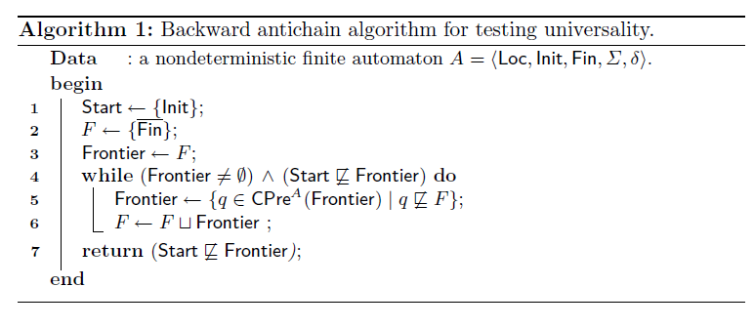
A Fixed Point to Solve Universality

Slide 24
Using the Dual Lattice of Antichains to Solve Universality
Post^{A}(q)= ⎣{s|∃s’∈q, ∃σ∈∑: s=post_{σ}^{A}(s’)}⎦
Theorem3 Let A = <Loc, Init, Fin, Σ, δ > be an NFA, and let ~F=~∏{q| q=Post^{A}(q) ~∏{Init}}. Then Lang(A)≠∑*, iff ~F ~⊑{Fin}

Slide 25
Relationship between Forward and Backward Algorithms
Given an NFA A = <Loc, Init, Fin,∑, δ>, the reverse of A is the NFA B = <Loc, Fin, Init, ∑, δ’>.
pre_{σ}^{A}(s)=post_{σ}^{B}(s).
For a set s ⊆ Loc, let s be the complement of s relative to Loc, that is, s = Loc\s.
For a set q ⊆2^{Loc}, let ~q={s| s∈q}.
~q is antichain iff q is an antichain, and ~ ⎣q⎦= ⎡~q ⎤

Slide 26
Relationship between Forward and Backward Algorithms
Lemma4 Let A = <Loc, Init, Fin,∑,δ > be an NFA, let B be its reverse, and let q be an antichain over Loc. Then q’=CPre^{A}(q) iff ~q’=Post^{B}(~q)
Proof
~q’=~CPre^{A}(q)=~⎡{s|∃s’∈q ∃σ∈∑: s=cpre_{σ}^{A}(s’)}⎤
= ⎣~ {s|∃s’∈q ∃σ∈∑: s=cpre_{σ}^{A}(s’)} ⎦
= ⎣ {s|∃s’∈q ∃σ∈∑: s=cpre_{σ}^{A}(s’)} ⎦
= ⎣ {s|∃s’∈q ∃σ∈∑: s=cpre_{σ}^{A}(s’)} ⎦
= ⎣ {s|∃s’∈q ∃σ∈∑: s=pre_{σ}^{A}(s’ )} ⎦
= ⎣ {s|∃s’∈q ∃σ∈∑: s=post_{σ}^{B}(s’ )} ⎦
=Post^{B}(~q)

Slide 27
Comparison with Explicit Determinization
Theorem5 For checking universality, there exists an infinite family of NFAs A_{k}, with k≥2 states, for which the forward subset algorithm is exponential, and the (forward and backward) antichain algorithms are polynomial.
There also exists an infinite family of NFAs B_{k} for which the backward subset algorithm is exponential, and the antichain algorithms are polynomial.

Slide 28
Comparison with Explicit Determinization
Proof
Subset Construction:
0
{l₀}
{l₀}
0
{l₀ , l₃}
1
0
1
{l₀ , l₁}
{l₀ , l₂}
{l₀ , l₁, l₃}
0
{l₀ , l₂, l₃}
1
{l₀ , l₁, l₂}
1
{l₀ , l₁, l₂ l₃}

Slide 29
Comparison with Explicit Determinization
Backward antichain algorithm terminates in polynomial time:
q₀={{l_{k}}}
…
q_{k-1}={{l₁,…,l_{k}}}
q_{k}={{l₁,…,l_{k}}}
The test {Init} ⊑ q_{k} requies linear time.
The forward antichain algorithm terminates after a single iteration with ~F = {Init}, and the test ~F ~⊑{{l_{k}}} is done in constant time.
A similar proof holds for the second part of the theorem: for the family B_{k}, k≥2, choose each B_{k} to be the reverse of A_{k}. ∎

Slide 30
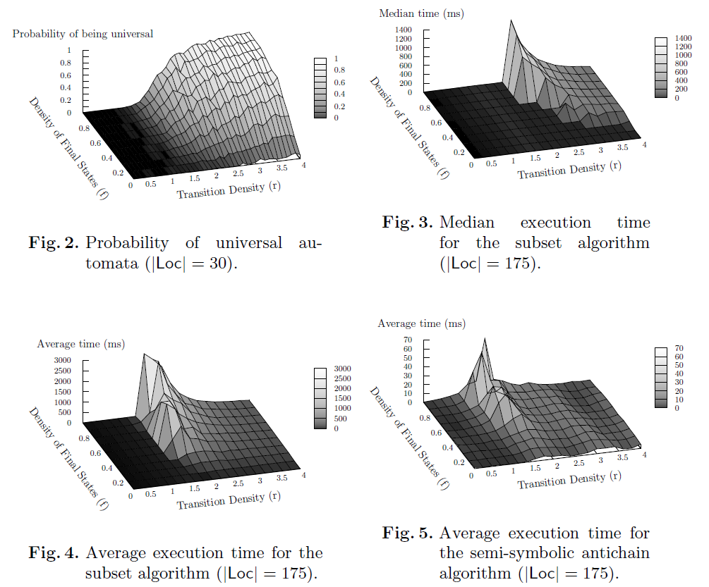
Pratical Evaluation

Slide 31
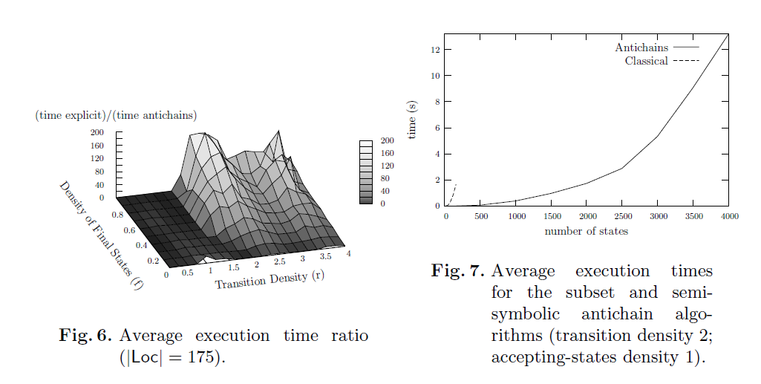

Slide 32
Language Inclusion
Consider two NFAs A = <Loc_{A}, Init_{A}, Fin_{A},∑, δ_{A}> and B = <Loc_{B}, Init_{B}, Fin_{B}, ∑, δ_{B}> over the same alphabet.
We wish to check whether Lang(A) ⊆Lang(B).
An antichain over Loc_{A} × 2^{LocB} is a set q∈2^{LocA×2LocB} such that for all (l₁, s₁), (l₂, s₂)∈q with l₁ = l₂ and s₁ ≠ s₂, we have neither s₁ ⊆ s₂ nor s₂ ⊆ s₁.

Slide 33
Language Inclusion
Given a set q∈2^{LocA×2LocB}, an element (l,s) ∈q is maximal iff for every s’ with s’⊃s, we have (l,s’)∉q and we denote ⎡q⎤ the set of maximal elements of q.
q ⊑_{l} q’ iff ∀(l,s) ∈q ∃(l,s’) ∈q’: s⊆s’
q ⊔_{l} q’ =⎡{(l,s)| (l,s)∈q ∨(l,s) ∈q’} ⎤
q ⊓_{l} q’= ⎡{(l,s∩s’)| (l,s)∈q ∧(l,s’) ∈q’}⎤
CPre_{l}(q)= ⎡{(l,s)|∃σ∈∑ ∃(l’,s’) ∈q : l’ ∈ δ_{A}(l, σ) ∧ post_{σ}^{B}(s)⊆s’} ⎤

Slide 34
Language Inclusion
Theorem6 Let A and B be two finite automata, and let F_{l} = ∏_{l}{q | q = CPre_{l} (q)⊔_{l}(Fin_{A}×{Fin_{B}})}. Then Lang(A) ⊄ Lang(B) iff there exists a state l∈ Init_{A} such that {(l, Init_{B})} ⊑_{l} F_{l}.
Theorem7 For a set A₁, . . . ,A_{n} of DFAs and an NFA B, we define the sum C = A₁⊕· · ·⊕A_{n} ⊕ B. Then Lang(A1)∩. . . ∩ Lang(An)⊆Lang(B) iff Lang(C) =∑* .

Slide 35
Emptiness of Alternating Automata
An alternating finite automation(AFA) is a tuple A=<Loc, Init, Fin, ∑, ρ>.
ρ: Loc×∑→B⁺(Loc)
B⁺(Loc) is the set of monotone boolean formulars over Loc, defined by the gramma ϕ::=true| l|ϕ∧ϕ| ϕ∨ϕ, l∈Loc.
For example, ρ(l,w)=l₁∨(l₂∧l₃) means that in state l, a word of the form σ•w is accepted if either w is accepted in l₁, or w is accepted in both l₂ and l₃.
A set s⊆ Loc of states satisfies a formula ϕ∈B⁺(Loc) (denoted by s⊨ϕ) iff ϕ is equivalent to true when the states in s are replaced by true, and the states in Loc\s by false.

Slide 36
Emptiness of Alternating Automata
A run of the AFA A over a finite word w is a tree T = (N,⇒), whose nodes are a prefix-closed set N ⊆ Loc⁺ of nonempty sequences of states.
The set N contains a single node at the root, which is a set in Init.
⇒ ⊆N×N, satisfies the conditions:
If x ⇒x’, then x’=x•l for some l∈Loc.
If |x|≤|w|, then the set s={last(x’)| x⇒x’} is such that s⊨ ρ(last(x),w(|x|)).
A run T is accepting iff last(x) ∈ Fin for all leaves x of T .

Slide 37
Emptiness of Alternating Automata
The emptiness problem for AFAs is to decide, given an AFA A, whether Lang(A) = φ.
Since complementation of AFAs is easy (by dualizing the transition function and complementing the set of accepting states), the universality problem for AFAs is polynomially equivalent to emptiness.

Slide 38
Emptiness of Alternating Automata
Cpre_{a}(q)=⎡{s| ∃s’∈q ∃σ∈∑ ∀l∈s: s’ ⊨ ρ(l, σ)} ⎤
Theorem 8 Let A = <Loc, Init, Fin, Σ, ρ > be an AFA, and let F_{a}=∏{q| q=CPre_{a} (q) ⊔{Fin}}. Then Lang(A)≠ Φ, iff {Init} ⊑F_{a}.

