Slide 1
An Introduction to the Model Verifier verds
Wenhui Zhang
September 15th, 2010

Slide 2
Contents
(1) On boolean diagram model checking
(2) On bounded semantics model checking
(3) On the model verifier verds

Slide 3
Boolean Diagram Model Checking
A kind of symbolic model checking.
Based on boolean diagrams for boolean function manipulation.
Different from the usual symbolic model checking based on decision diagrams.
Initial experimental evaluation based on random boolean programs shows that it has significant advantages over symbolic model checking based on decision diagrams.

Slide 4
Bounded Semantics Model Checking
A kind of bounded model checking.
Based on bounded semantics that can be used for both bounded verification and bounded error detection.
Different from the usual bounded model checking based on bounded semantics of existential temporal logics.
Initial experimental evaluation shows that it has advantages over symbolic model checking in a large percentage of the test cases, where both verification and error detection problems are well represented.

Slide 5
verds: a Model Verifier
Type of Systems:
Just discrete systems (fair Kripke structures) implmented by a set of concurrent processes
Type of Properties:
Computation Tree Logic (CTL)
Verification Techniques:
Boolean diagram model checking
Bounded semantics model checking (without fairness)

Slide 6
Contents
On boolean diagram model checking
(a) Boolean diagrams (in particular, TBDs)
(b) A connection of TBDs to model checking
(2) On bounded semantics model checking
(3) On the model verifier verds

Slide 7
Boolean diagrams
BD = <N,E,n₀,L>
Labeling function
Root
Edges
Nodes

Slide 8
BD = <N,E,n₀,L> : Nodes (N)

Slide 9
k-ary BD: Ordered Edges (E: N -> N^{k})
Note: E is a partial function
Note: k=3 is used in the following application

Slide 10
TBD: Root Node (n₀∈N)

Slide 11
TBD: Labels (L: N -> L∪-L)
A
B
B
- C
A
- C
- D
- D
- D
D
- A
L ={A,…,D}, -L={-A,…,-D}

Slide 12
Language: Subset of (L∪-L)*
Language: Accepted Strings of Labels
A string is accepted by a TBD,
if the TBD can be simplified to a positive terminal node,
according to given simplification rules.

Slide 13
Simplification on a Pos./Neg. Label
A
B
B
- C
A
- C
- D
- D
- D
D
- A
Select all nodes with the same label (regardless of the sign)
Select among the nodes in which all successors of the node are terminals
Replace the selected nodes with a simpler one according to given rules

Slide 14
Simplification for a Positive Node
u
- u
u
~x
~y
- z
- z
- z
~x
~y
z
~x
~y

Slide 15
Simplification for a Negative Node
- u
- u
u
~x
~y
- z
z
z
~x
~y
z
- ~x
- ~y

Slide 16
Two Examples: No Accepted Strings
A
B
B
- C
A
- C
- D
- D
- D
D
- A
- A

Slide 17
Example: An Accepted String
A
B
B
- C
A
- C
- D
- D
- D
D
- A
- A
- C
A
B
- D
A

Slide 18
Example: An Accepted String
A
B
B
- C
- A
- C
- D
- D
- A
- A
- C
A
B
- D
A

Slide 19
Example: An Accepted String
A
B
B
D
- A
- C
- D
- A
- C
A
B
- D
A

Slide 20
Example: An Accepted String
A
B
B
D
- A
- C
- D
- A
- C
A
B
- D
A

Slide 21
Example: An Accepted String
A
- D
B
D
- A
- C
A
B
- D
A

Slide 22
Example: An Accepted String
A
- D
B
D
- A
- C
A
B
- D
A

Slide 23
Example: An Accepted String
B
- A
- C
A
B
- D
A

Slide 24
Models: Subsets of L
_{m: Subset}
A
B
C
D
Exists an accepted string s such that
x in s implies (x>0 and x in m) or (x<0 and –x not in m)

Slide 25
Example: A Model
A
B
B
- C
A
- C
- D
- D
- D
D
- A
A
- B
- C
A
{ A } is a model.

Slide 26
Concepts Related to Models
A TBD is complete,
if every subset of the positive labels is a model.
Two TBDs are equivalent,
if they have the same set of models.

Slide 27
Boolean Formulas as TBDs
_{V: Subset}
A
B
C
D
Consider a boolean formula φ with variables in V
m is a model of φ iff
φ evaluates to true under the assignment such that …….

Slide 28
Boolean Formulas as TBDs
_{V: Subset}
A
B
C
D
φ is equivalent to a TBD t iff
φ and t have the same set of models

Slide 29
Some Properties
A boolean formula is valid
iff its corresponding TBD is complete.
Two boolean formulas are equivalent
iff their corresponding TBDs are equivalent.

Slide 30
Boolean Diagram Model Checking
Technical development
Ordered TBDs
Operations on ordered TBDs
Reduced ordered TBDs
Model checking == Manipulation of TBDs
Technical Details

Slide 31
Technical Reports
Wenhui Zhang.
Ternary Boolean Diagrams.
Technical Report ISCAS-LCS-10-15,
Institute of Software, Chinese Academy of Sciences. 2010.

Slide 32
Contents
(1) On boolean diagram model checking
(2) On bounded semantics model checking
Kripke structure
Semantics of CTL
(c) Bounded semantics of CTL
(d) A connection to model checking
(3) On the model verifier verds

Slide 33
Kripke Structure
KS = <S,R,I,L>
Labeling function
Initial States
Transition Relation
States

Slide 34
KS=<S,R,I,L>: States (S)

Slide 35
KS: Transition Relation (R⊆SxS)
Note: R is a total relation

Slide 36
KS: Initial States (I⊆S)

Slide 37
KS: Labels (L: S->2^{AP})
p
p,q
p,r
q,r
r
p,r
q,r
q
p,r
p,q,r

Slide 38
Computation/Paths
{p}
{p,q}

Slide 39
CTL Formulas
AX φ
AF φ
A( φ U Ψ )
AG φ
A( φ R Ψ )
EX φ
EF φ
E( φ U Ψ )
EG φ
E( φ R Ψ )

Slide 40
Semantics: M,s |= Aϕ or M,s |= Eϕ
X φ
F φ
Ψ U φ
G φ
Ψ R φ
s
φ
φ
Ψ
Ψ
Ψ
φ
φ
φ
φ
φ
φ
φ
φ
φ
φ
φ
φ
φ
φ
φ
φ
φ
Ψ

Slide 41
Bounded Semantics (k=4)
X φ
F φ
Ψ U φ
G φ
Ψ R φ
s
φ
φ
Ψ
Ψ
Ψ
φ
φ
φ
φ
φ
φ
φ
φ
φ
φ
φ
φ
φ
φ
φ
Ψ

Slide 42
Bounded Semantics (k=4)
X φ
F φ
Ψ U φ
G φ
Ψ R φ
s
φ
φ
Ψ
Ψ
Ψ
φ
internal loop
φ
φ
φ
φ
φ
internal loop
φ
φ
φ
φ
φ
φ
φ
φ
φ
Ψ

Slide 43
Soundness and Completeness
M,s |= ϕ
iff
there is a bounded model M_{k} such that
M_{k},s |= ϕ

Slide 44
BS Model Checking Principle
M,s |= ϕ :
s0: k=0;
s1: M_{k},s|= ϕ holds, report that ϕ holds;
s2: M_{k},s|= ¬ϕ holds, report that ϕ does not hold;
s3: increase k; goto s1.

Slide 45
BS Model Checking Algorithm
Formulate BS of CTL with QBF-formulas
Model checking CTL == Solving QBF-formulas
Formal Definitions and Technical Details

Slide 46
Technical Reports/Papers
Wenhui Zhang.
Bounded Semantics of CTL.
Technical Report ISCAS-LCS-10-16,
Institute of Software, Chinese Academy of Sciences. 2010.
Wenhui Zhang.
Bounded Semantics of CTL and SAT-based Verification.
ICFEM 2009:286-305. 2009.

Slide 47
Contents
(1) On boolean diagram model checking
(2) On bounded semantics model checking
(3) On the model verifier verds
(a) Introduction to the tool “verds”
(b) Experimental evaluations

Slide 48
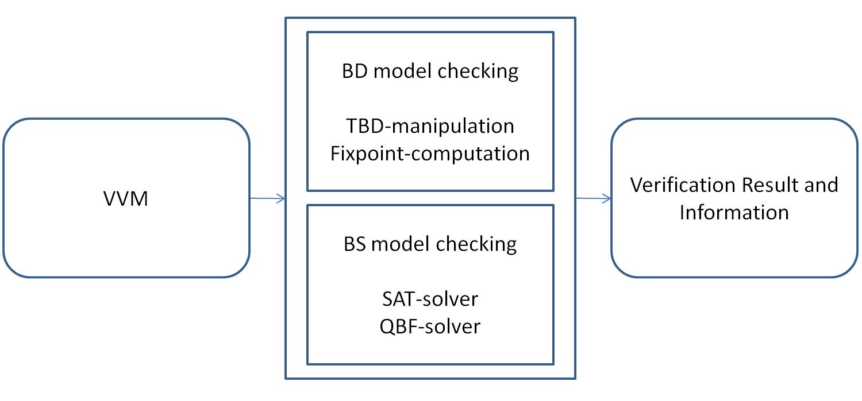
Structure of verds

Slide 49
Strength of verds (1)
Boolean diagram model checking :
efficient with respect to a set of test cases, except a few of them, in comparison with NuSMV 2.5.0;
Remarks:
The test cases are combinations of:
2 types of random boolean programs, and a set of 24 CTL formulas.

Slide 50
Strength of verds (2)
Bounded semantics model checking:
efficient in over half of the same test cases, in comparison
with boolean diagram model checking with “verds”.
Remarks:
The efficiency depends very much on the QBF-solving techniques:
external QBF-solvers may be used to increase the efficiency.
For ACTL formulas, the use of SAT-solving techniques may be more efficient.

Slide 51
Modeling and Specification
Models: Just discrete systems
Properties: CTL properties

Slide 52
Just Discrete Systems
D = <V,Θ,ρ,Ј>
V : A finite set of typed system variables, such that
the domain of each variable must be finite.
Θ : An assertion characterizing the initial states.
ρ : An assertion ρ(V,V') relating the variables in V to
the variables in V' of a successor state.
J : A set of justice requirements (weak fairness).

Slide 53
Specification Language: CTL
AX φ
AF φ
A( φ U Ψ )
AG φ
A( φ R Ψ )
EX φ
EF φ
E( φ U Ψ )
EG φ
E( φ R Ψ )
A proposition is written as “e1 op e2” where
e1,e2 are expressions and
op is an operator comparing the values of the expressions.

Slide 54
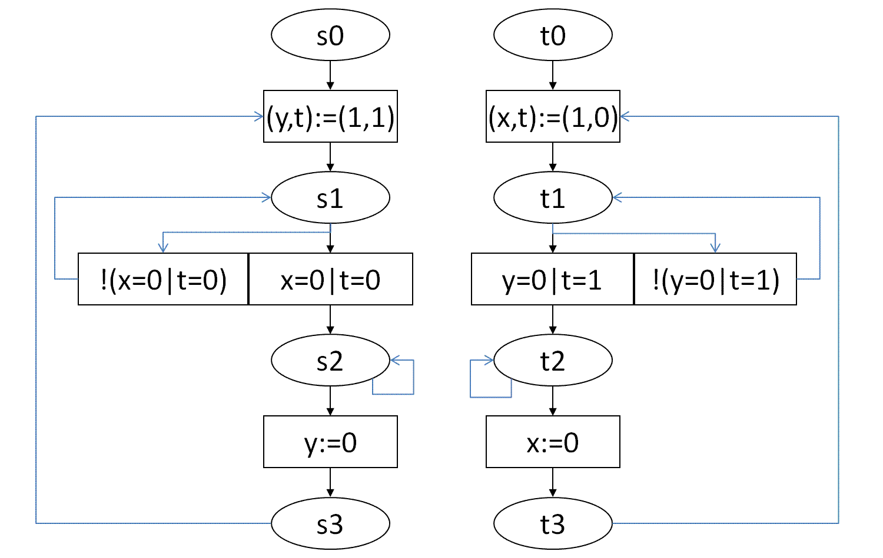
An Example: Mutual Exclusion

Slide 55
Mutual Exclusion (Part 1)
VVM me005
VAR
x[0..1]: 0..1; t: 0..1;
INIT
x[0]=0; x[1]=0; t=0;
PROC
p0: p0m(x[],t,0);
p1: p0m(x[],t,1);
SPEC
AG(!(p0.a=s2&p1.a=s2));
AG((!p0.a=s1|AF(p0.a=s2|p1.a=s2))&
(!p1.a=s1|AF(p0.a=s2|p1.a=s2)));
AG((!p0.a=s1|AF(p0.a=s2))&(!p1.a=s1|AF(p1.a=s2)));
AG((!p0.a=s1|EF(p0.a=s2))&(!p1.a=s1|EF(p1.a=s2)));

Slide 56
Mutual Exclusion (Part 2)
MODULE p0m(x[],t,i)
VAR
a: {s0,s1,s2,s3};
INIT
a=s0;
TRANS
a=s0: (x[1-i],t,a):=(1,1-i,s1);
a=s1&(x[i]=0|t=i): (a):=(s2);
a=s1&!(x[i]=0|t=i): (a):=(s1);
a=s2: (x[1-i],a):=(0,s3);
a=s2: (a):=(s2);
a=s3: (x[1-i],t,a):=(1,1-i,s1);
FAIRNESS
running;

Slide 57
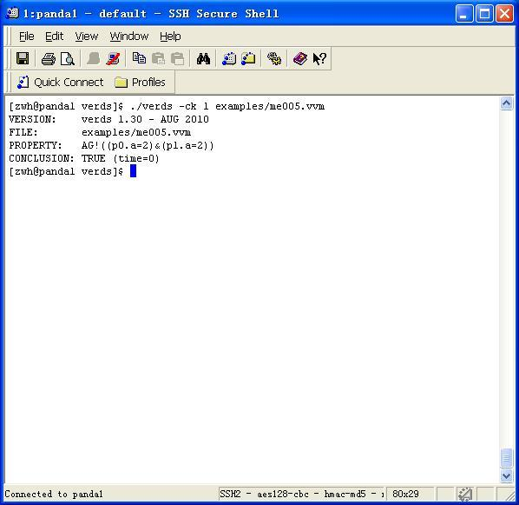
BD Model Checking

Slide 58
BD Model Checking
verds -ck 1 me005.vvm
VERSION: verds 1.30 - AUG 2010
FILE: me005.vvm
PROPERTY: AG!((a=2)&(b=2))
CONCLUSION: TRUE (time=0)

Slide 59
BD Model Checking
verds -ck 2 me005.vvm
VERSION: verds 1.30 - AUG 2010
FILE: me005.vvm
PROPERTY: AG((!(p0.a=1)|AF((p0.a=2)|(p1.a=2)))&……
CONCLUSION: TRUE (time=0)

Slide 60
BD Model Checking
verds -ck 3 me005.vvm
VERSION: verds 1.30 - AUG 2010
FILE: me005.vvm
PROPERTY: AG((!(p0.a=1)|AF(p0.a=2))& (!(p1.a=1)|AF(p1.a=2)))
CONCLUSION: FALSE (time=0)
Remark:
Needs an additional fairness constraint: a!=s2 for the 2 processes

Slide 61
BD Model Checking
verds -ck 4 me005.vvm
VERSION: verds 1.30 - AUG 2010
FILE: me005.vvm
PROPERTY: AG((!(p0.a=1)|EF(p0.a=2))&(!(p1.a=1)|EF(p1.a=2)))
CONCLUSION: TRUE (time=0)

Slide 62
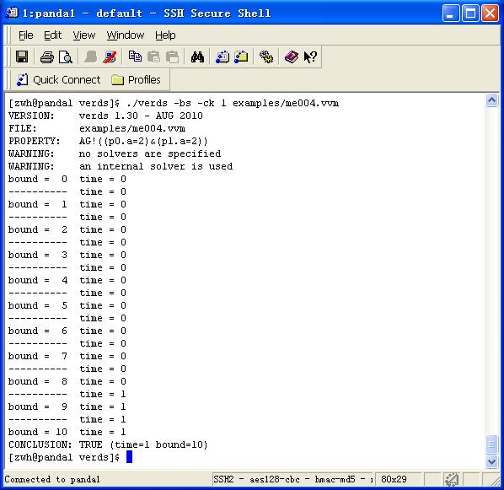
BS Model Checking (without fairness)

Slide 63
BS Model Checking (without fairness)
verds -bs -ck 1 me004.vvm
VERSION: verds 1.30 - AUG 2010
FILE: me004.vvm
PROPERTY: AG!((a=2)&(b=2))
WARNING: no solvers are specified
WARNING: an internal solver is used
bound = 0 time = 0
---------- time = 0
bound = 1 time = 0
.
.
bound = 10 time = 1
CONCLUSION: TRUE (time=1 bound=10)

Slide 64
BS Model Checking (without fairness)
verds -bs -ck 2 me004.vvm
VERSION: verds 1.30 - AUG 2010
FILE: me004.vvm
PROPERTY: AG((!(p0.a=1)|AF((p0.a=2)|(p1.a=2)))&……
WARNING: no solvers are specified
WARNING: an internal solver is used
bound = 0 time = 0
---------- time = 0
bound = 1 time = 0
---------- time = 0
bound = 2 time = 0
---------- time = 0
CONCLUSION: FALSE (time=0 bound=2)

Slide 65
BS Model Checking (without fairness)
verds -bs -ck 3 me004.vvm
VERSION: verds 1.30 - AUG 2010
FILE: me004.vvm
PROPERTY: AG((!(p0.a=1)|AF(p0.a=2))& (!(p1.a=1)|AF(p1.a=2)))
WARNING: no solvers are specified
WARNING: an internal solver is used
bound = 0 time = 0
---------- time = 0
bound = 1 time = 0
---------- time = 0
bound = 2 time = 0
---------- time = 0
CONCLUSION: FALSE (time=0 bound=2)

Slide 66
BS Model Checking (without fairness)
verds -bs -ck 4 me004.vvm
VERSION: verds 1.30 - AUG 2010
FILE: me004.vvm
PROPERTY: AG((!(p0.a=1)|EF(p0.a=2))&(!(p1.a=1)|EF(p1.a=2)))
WARNING: no solvers are specified
WARNING: an internal solver is used
bound = 0 time = 0
---------- time = 0
bound = 1 time = 0
.
.
bound = 10 time = 394
CONCLUSION: TRUE (time=394 bound=10)

Slide 67
Experimental Evaluations
Test Cases:
Random Programs with Concurrent Processes
Random Programs with Concurrent Sequential Processes
24 CTL properties
Experimental Details

Slide 68
Summary of the Evaluations
With respect to the experimental data:
Boolean diagram model checking has clear advantages over BDD-based symbolic model checking with NuSMV.
Bounded semantics model checking and
boolean diagram model checking have their own advantages.

Slide 69
Documentation
http://lcs.ios.ac.cn/~zwh/verds

Slide 70
Concluding Remarks
Boolean diagram model checking, bounded semantics model checking, and the model verifier “verds” with its modeling language and specification language have been presented.
Two distinguished features of “verds” are that it supports boolean diagram model checking based on TBDs and bounded semantics model checking based on QBF.

Slide 71
Future Works
Future works include:
various practical improvements to the model verifier, and
theoretical works on TBDs and bounded semantics.

Slide 72
Some Practical Issues
Model Checking:
Implementation of cone of influence reduction
Implementation of partitioned transition relation
Implementation of counter-example generation
Improvement of the relational product computation
QBF/SAT:
Improvement of the encoding of problems
Improvement of the QBF/SAT-solving algorithms

Slide 73
Some Theoretical Issues
On TBDs:
Succinctness of representation of a formula;
Complexity of the operation “conjunction”;
On Bounded Semantics Model Checking:
Bounded semantics for various temporal logics;
On CTL properties that have linear counterexamples;

